Slide 1





XML Processing
Exporting and Importing Data From XML Format
Databases
Frameworks
SoftUni Team
Technical Trainers
Software University
http://softuni.bg

Slide 2

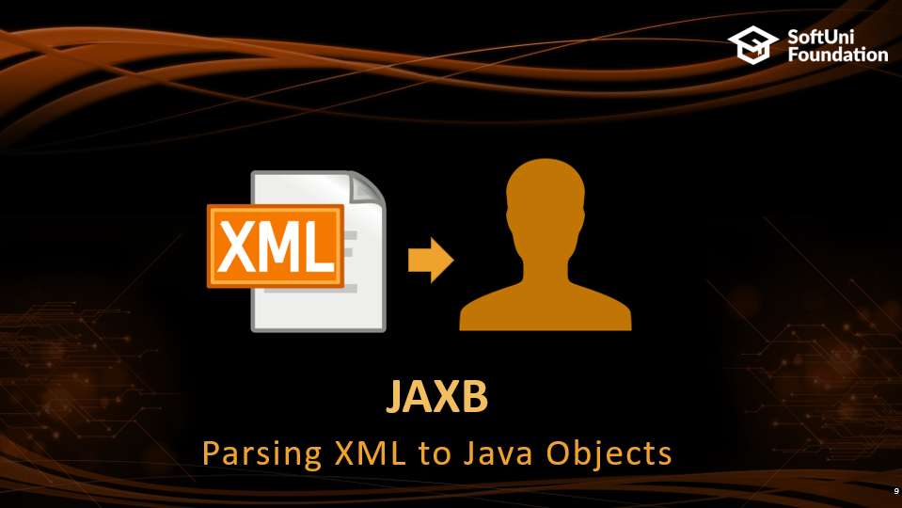
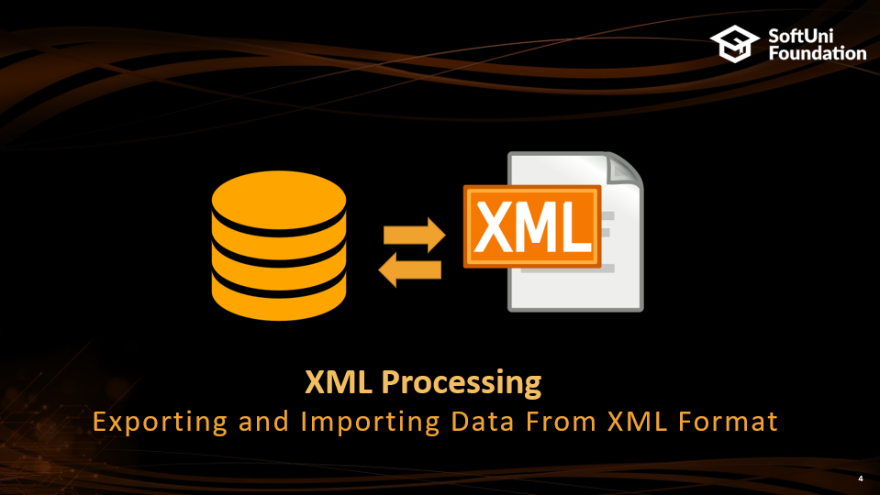
Table of Contents

Slide 3
Questions
sli.do #JavaDB

Slide 4

XML Processing
Exporting and Importing Data From XML Format

Slide 5
XML Specifics
EXtensible Mark-up Language
Lightweight format that is used for data interchanging
XML is language independent
Primarily used to transmit data between a server and web application
Java, PHP, C#
JavaScript
XML format
Client
Server
person.js
person.xml
PersonController.java
car.js
car.xml
CarController.java

Slide 6
XML Markup and Content
An XML document consists of strings that:
Constitute markup – usually begin with < and end with >
Are content – placed between markup(tags)
E.g.:
person.xml
<?xml version="1.0" encoding="UTF-8">
<person>
<firstName>Teodor</firstName>
</person>
Markup tags for Person Object
Content
(Person Name)

Slide 7
XML Structure
XML documents are formed as element trees
An XML tree starts at a root element and branches from the root to sub elements
All elements can have child ones:
person.xml
Root
<?xml version="1.0" encoding="UTF-8">
<person>
<firstName>Teodor</firstName>
<address>
<country>Bulgaria</country>
<city>Stara Zagora</city>
</address>
</person>
Prolog
Tag
XML Element
Child
Closing Tag

Slide 8
XML Structure (2)
person.xml
<?xml version="1.0" encoding="UTF-8">
<person>
<phoneNumbers>
<phoneNumber>
<number>08983248798</number>
</phoneNumber>
<phoneNumber>
<number>08983243143</number>
</phoneNumber>
</phoneNumbers>
</person>
Wrapper

Slide 9


JAXB
Parsing XML to Java Objects

Slide 10
JAXB
Processes the schema of the XML document into a set of Java classes that represent it
Generates compact and readable XML output
pom.xml
<dependency>
<groupId>com.sun.xml.bind</groupId>
<artifactId>jaxb-impl</artifactId>
</dependency>

Slide 11
JAXB Basics
Marshalling - converting a Java Object to XML
Unmarshalling - converting XML to Java Object
We need to annotate the Java Object to provide instructions for XML creation:
AddressDto.java
@XmlRootElement(name = "address")
@XmlAccessorType(XmlAccessType.FIELD)
public class AddressDto implements Serializable {
@XmlAttribute(name = "country")
private String country;
@XmlElement(name = "city")
private String city;
}

Slide 12
JAXB Annotations
@XmlRootElement – defines XML root object
@XmlAccessorType
XmlAccessType.FIELD, XmlAccessType.PROPERTY, XmlAccessType.PUBLIC_MEMBER
@XmlAttribute – marks the field as an attribute to the object
@XmlElement – marks the field as an element
@XmlElementWrapper(name = “…") – wraps the array of objects
@XmlTransient – the field won’t be exported/imported

Slide 13
JAXB Initialization
JAXBContext objects are responsible for the XML manipulations
JAXBContext.newInstance(object.getClass()) - creates an instance of JAXBContext
object.getClass is the class that we will export/import
E.g. User, Address, Employee…
XMLParser.java
this.jaxbContext = JAXBContext.newInstance(object.getClass());

Slide 14
Export Single Object to XML - Example
User.java
@XmlRootElement
@XmlAccessorType(XmlAccessType.FIELD)
public class User {
@XmlElement(name = "name")
private String name;
@XmlElement(name = "age")
private Integer age;
public String getName() {
return name;
}
// Constructor, getters, setters
users.xml
<?xml version="1.0" encoding="UTF-8" standalone="yes"?>
<user>
<name>New User</name>
<age>18</age>
</user>
XMLParser.java
JAXBContext context = JAXBContext.newInstance(User.class);
Marshaller marshaller = context.createMarshaller();
marshaller.marshal(user, new File("users.xml"));
Creates XML file "users.xml"

Slide 15
Export Single Object to XML – Example 2
AddressDto.java
@XmlRootElement(name = "address")
@XmlAccessorType(XmlAccessType.FIELD)
public class AddressDto implements Serializable {
@XmlAttribute(name = "country")
private String country;
@XmlElement(name = "city")
private String city;
}
address.xml
<?xml version="1.0"
encoding="UTF-8"?>
<address country="Bulgaria">
<city>Sofia</city>
</address>
Object attribute
XMLParser.java
Marshaller jaxbMarshaller = jaxbContext.createMarshaller();
jaxbMarshaller.setProperty(Marshaller.JAXB_FORMATTED_OUTPUT, true);
OutputStream outputStream = new FileOutputStream(fileName);
BufferedWriter bfw =
new BufferedWriter(new OutputStreamWriter(outputStream));
jaxbMarshaller.marshal(object, bfw);
Format XML output
(Analogically to setPrettyPrinting in JSON parsing)

Slide 16
Export Single Object to XML
AddressDto.java
@XmlRootElement(name = "address")
@XmlAccessorType(XmlAccessType.FIELD)
public class AddressJsonDto implements Serializable {
@XmlAttribute(name = "country")
private String country;
@XmlElement(name = "city")
private String city;
}
address.xml
<?xml version="1.0" encoding="UTF-8"?>
<address country="Bulgaria">
<city>Sofia</city>
</address>

Slide 17
Export Multiple Objects to XML
AddressesDto.java
@XmlRootElement(name = "addresses")
@XmlAccessorType(XmlAccessType.FIELD)
public class AddressesDto {
@XmlElement(name = "address")
private List<AddressDto> addressJsonDtos;
}
XMLParser.java
AddressesDto addressDtos = new AddressesDto(); jaxbMarshaller.marshal(addressesDto, bfw);

Slide 18
Export Multiple Objects to XML (2)
XMLParser.java
AddressesDto addressDtos = new AddressesDto(); jaxbMarshaller.marshal(addressesDto, bfw);
addresses.json
<?xml version="1.0" encoding="UTF-8" standalone="yes"?>
<addresses>
<address country="Bulgaria">
<city>Sofia</city>
</address>
<address country="Spain">
<city>Barcelona</city>
</address>
</addresses>

Slide 19
Import Single Object from XML
AddressDto.java
@XmlRootElement(name = "address")
@XmlAccessorType(XmlAccessType.FIELD)
public class AddressDto implements Serializable {
@XmlAttribute(name = "country")
private String country;
@XmlElement(name = "city")
private String city;
}
XMLParser.java
JAXBContext jaxbContext = JAXBContext.newInstance(AddressDto.class);
InputStream inputStream = getClass().getResourceAsStream("/files/input/xml/address.xml");
BufferedReader bfr = new BufferedReader(new InputStreamReader(inputStream));
Unmarshaller unmarshaller = jaxbContext.createUnmarshaller();
AddressDto addressDto = (AddressDto) unmarshaller.unmarshal(bfr);
Creates Object

Slide 20
Import Single Object from XML
AddressDto.java
address.xml
@XmlRootElement(name = "address")
@XmlAccessorType(XmlAccessType.FIELD)
public class AddressDto implements Serializable {
@XmlAttribute(name = "country")
private String country;
@XmlElement(name = "city")
private String city;
}
<?xml version="1.0" encoding="UTF-8" standalone="yes"?>
<address country="Bulgaria">
<city>Sofia</city>
</address>

Slide 21
Import Multiple Objects to XML
XMLParser.java
JAXBContext jaxbContext = JAXBContext.newInstance(AddressesDto.class);
InputStream inputStream = getClass().getResourceAsStream("/files/input/xml/addresses.xml");
BufferedReader bfr = new BufferedReader(new InputStreamReader(inputStream));
Unmarshaller unmarshaller = jaxbContext.createUnmarshaller();
AddressesDto addressesDto = (AddressesDto) unmarshaller.unmarshal(bfr);
addresses.xml
<?xml version="1.0" encoding="UTF-8" standalone="yes"?>
<addresses>
<address country="Bulgaria">
<city>Sofia</city>
</address>
<address country="Spain">
<city>Barcelona</city>
</address>
</addresses>

Slide 22


Summary
XML is another way to transfer data besides JSON
XML document's format consists of markup and content elements
JAXB is a library which helps us to read XML files and parse them to Java objects
XML

Slide 23







XML Processing
https://softuni.bg/courses/databases-advanced-hibernate

Slide 24
License
This course (slides, examples, demos, videos, homework, etc.) is licensed under the "Creative Commons Attribution-NonCommercial-ShareAlike 4.0 International" license
Attribution: this work may contain portions from
"Databases" course by Telerik Academy under CC-BY-NC-SA license

Slide 25




Free Trainings @ Software University
Software University Foundation – softuni.org
Software University – High-Quality Education, Profession and Job for Software Developers
softuni.bg
Software University @ Facebook
facebook.com/SoftwareUniversity
Software University Forums
forum.softuni.bg

